Slide 1
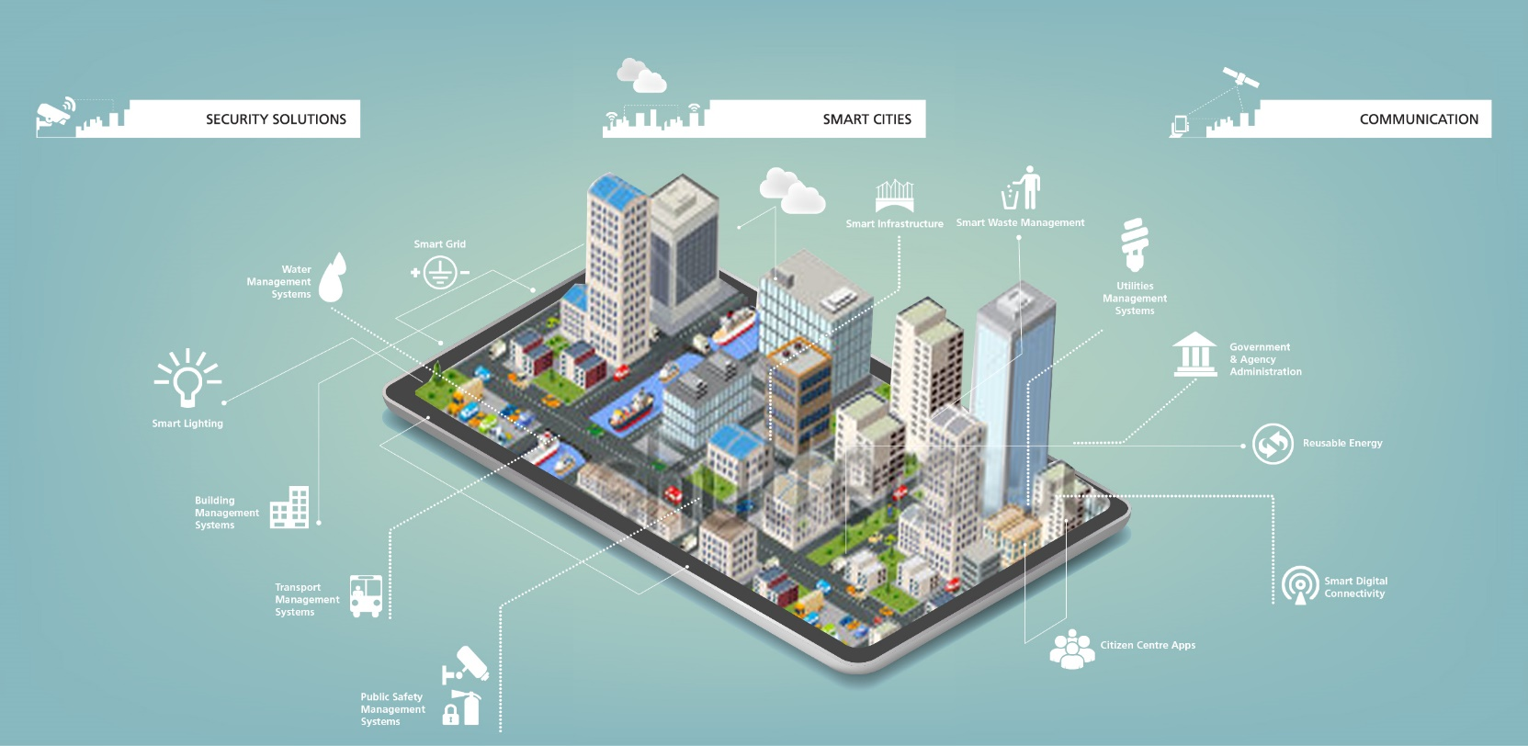

Smart World & Communication BU
Digital Initiatives

Slide 2









Digital Initiatives in SWC BU
Project Monitoring
Employee Engagement - (FB@Work)
SharePoint-Document Management
Barcode Inventory Management
Applications/apps
Workforce Management System –
GIS Application
Vehicle Tracking System
Management Dashboards

Slide 3
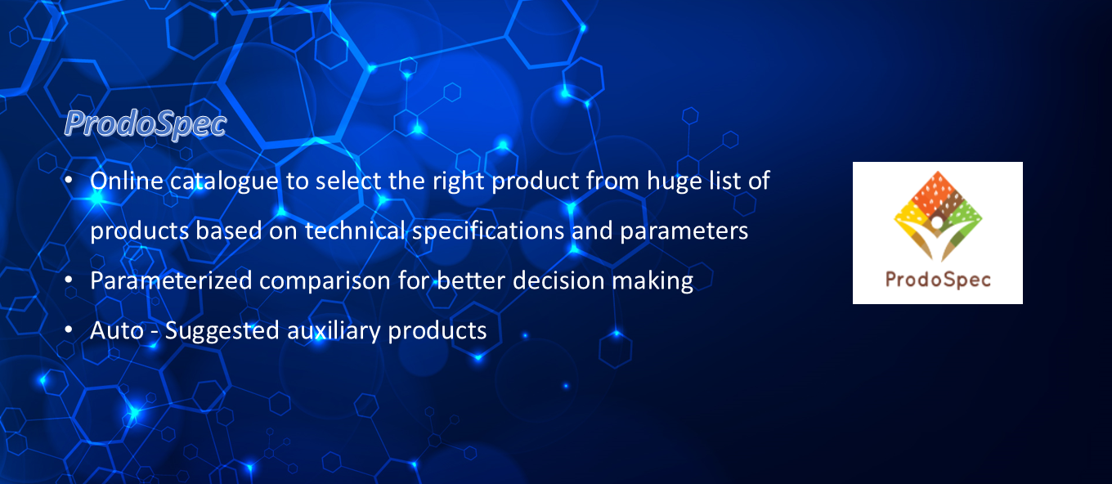

Slide 4

Service Engg Tracking
Engineer get notified of service tickets and tagged to the sites which are geo-tagged
Mobile based app to capture status update on the go
Central dashboard to monitor the progress

Slide 5
Bar-code Inventory Tracking
Track every single movement of material right from the supplier stage till the installation at site
Record and monitor the flow and optimize
Spot the bottleneck and highlight

Slide 6

Quality Inspection App
Enables on-the-spot quality parameter capture thru mobile app
Streamlined workflow
Transparent and audit ready

Slide 7
Executive Dashboards
Anything and everything about our business at finger tips, be it projects, internal process, departments, etc.
Pictorial representation of facts for easy understanding
Real-time data enables better advised decision making

Slide 8

Warranty Tracking
Smart warranty expiry alerts keeps the assets up & running at minimal costs
Timely highlights to save huge maintenance costs

Slide 9

Procube
Complete palette of projects’ progress data converge to single platform real time.
Top-down drilling on facts enable complete status track

Slide 10
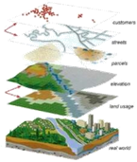
GIS based Survey
Complete digitizing of physical environment for better capture of information
Asymmetric nature captured with minimal deviation for educated designing of practically inaccessible locations

Slide 11

GPS Vehicle Tracking
Paperless digital log books avoiding manual data entry
Employee wise trip info available for optimization
Mobile app for map based reports
Visibility into over / underutilization leads to optimization of the usage.
Potential of 10 to 15% of 70Lakh worth expenditure optimization

Slide 12

FB @ Work
Engages employees based out at geographically disperse location
Easy, fast and friendly mode of communication
Best way of communicating to mass and returning the surveys

Slide 13

SharePoint
Central Repository of data authenticated by User Access
Shareable Secured data available on cloud accessible on the go
Centrally controlled data security

Slide 14

Safe Arms
Mobile app based EHS checklists filling and approval
Proactive hazard and risk warnings to prevent incidents
Central repository for EHS related documents

Slide 15

QIR (Quality Incident Reporting App)
Quality violation observation tracking system
Enhance quality standards
Improves customer satisfaction by providing quality products

Slide 16

Standard Solution Doc
Standard template for solution proposal document for every project
A User Guide for pre-bid team system architecture, OEM, application etc.
A comprehensive self training system.

Slide 17


